Slide 1
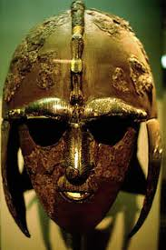
The Anglo-Saxon Period 449-1066 A. D.

Slide 3
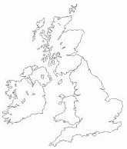
Label the numbered sections on the map of Great Britain.
1.
2.
Scotland
Northern Ireland
Ireland
Wales
England
3.
4.
5.

Slide 4
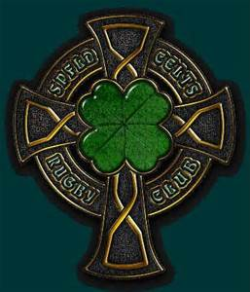
Anglo-Saxons
English traditions and language owe something to each of the island’s invaders.
A. They were first invaded by Iberians, then by the Celts, by the Romans, by the Angle-Saxons, by the Vikings, and by the Normans.
B. Since the time of the Magna Carta (1215) England has been a democracy in theory.
C. America is what it is today due to the influence of English parliamentary government, English literature, and the English language.

Slide 8
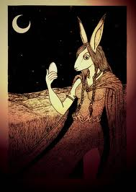
The Celts
The Celts were first called the Brythons.
- The religion of the Celts was a form of Animism – they saw spirits everywhere.
- These spirits controlled all aspects of existence.
Priests, called Druids, acted as
intermediaries between the gods and
the people.

Slide 12
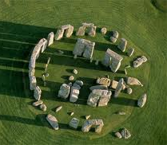
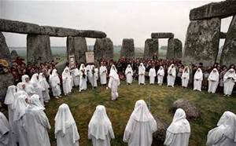
The Druids
1. Ritual dances
2. Human sacrifices
3. Stonehenge – used for religious rites having to do with lunar and solar cycles (some people believe)

Slide 13
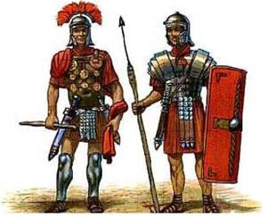
The Romans
The Romans invaded in 55 B.C. led by Julius Caesar. They remained in this area for about 100 years.
- Romans provided armies and organization that prevented further serious invasion for some time.
1. Built a network of roads
2. Built a great defensive wall 73 miles long.
3. Christianity gradually took hold.
4. Provided armies that prevented
further serious invasion

Slide 14
Nat. Geo. Clips
http://channel.nationalgeographic.com/the-truth-behind/videos/deadly-druid-rituals/
http://channel.nationalgeographic.com/the-truth-behind/videos/ancient-human-sacrifice/

Slide 15
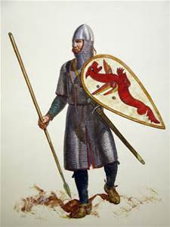
The Anglo-Saxons
Invaded in the middle of the fifth century
Angles and Saxons from Germany; Jutes from Denmark
The language of the Anglo-Saxons became the dominant language in the land
Angles = Angles land = Engla land = England

Slide 17
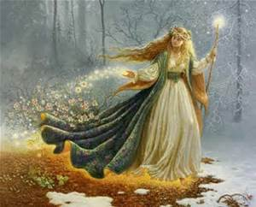
Differences between Celtic myths and Anglo-Saxon Poetry
Anglo-Saxon stories are mostly male-dominated. However Celtic legends are full of strong women.
Celtic myths are full of fantastic animals, passionate love affairs, and incredible adventures. They take place in enchanted lands where magic and the imagination rule.
- Celtic legends created King Arthur-the embodiment of English values.

Slide 18
Nat. Geo. Clip
http://channel.nationalgeographic.com/a-night-of-exploration/videos/a-window-on-anglo-saxon-life/

Slide 19
King Arthur
The Celts put up a strong resistance before retreating into Wales
Arthur – Welsh chieftain and heroic Celtic leader; Britain’s “once and future king”

Slide 20
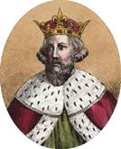
King Alfred of Wessex
(Ruled 871-899) known as Alfred the Great, was responsible for truly unifying England into a nation
1. Led the Anglo-Saxons against the invading Danes (fierce Vikings = pirates)
2. Christianity’s re-emergence helped King Alfred succeed by creating a common set of morals. It also linked England to Europe through the language of Latin.
3. Anglo-Saxons fought to protect their people, their culture and their church.
4. Started the Anglo-Saxon Chronicle which was a running history of England until 1154.

Slide 21
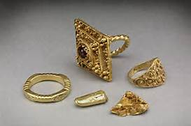
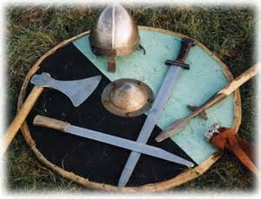
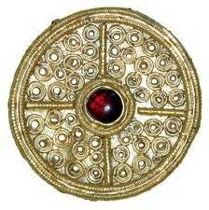
Sutton Hoo
Suffolk, England
Ship-grave containing:
Sword, gold, silver, bronze, coins, a helmet, buckles, serving vessels, and a harp

Slide 24
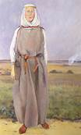
Women in Anglo-Saxon Culture
Inherited and held property
Christianity offered opportunities for women to join religious communities
Abbesses – women from noble families that were in charge of large double homes the included both a monastery and a nunnery

Slide 25
Anglo-Saxons
Anglo-Saxon life was dominated by the need to protect the clan and home against enemies.
A. Anglo-Saxons were not barbarians but they were a warring people.
B. The leader was responsible for law and order. He protected his people.
*In return the people must be loyal to the leader. (This is the only way fame, success, and even survival could be gained.)

Slide 26
Anglo-Saxons
Despite the growth of Christianity, the Anglo-Saxon religion remained strong.
A. The Anglo-Saxon religion was concerned with ethics and earthly virtues such as bravery.
B. Important religious figures for the Anglo-Saxons:
1. Woden (Wednesday – god of death, poetry, and magic. He helped humans communicate with spirits.

Slide 27
Anglo-Saxons
2. Thunor- god of thunder and lightening. His sign was the hammer and twisted cross.
3. Dragon – protector of the treasure. It was both a personification of “death and devourer” and guardian of the grave mound.

Slide 28
Anglo-Saxons
Anglo-Saxon poets (bards) held an honored position in society because they preserved heroic deeds in collective memory.
A. Poetry was as important as fighting, hunting, farming, or loving.
B. Non-Christian Anglo-Saxons, whose religion offered no hope of an afterlife, could only create a defense against death through poetry.
C. Communal halls were used for shelter, meetings, and entertainment.

Slide 29
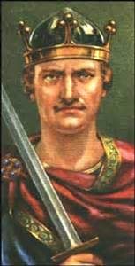
Anglo-Saxons
End of the Age
A. Edward the Conqueror, an Anglo-Saxon king, dies childless. Two men both claim the throne: Harold of England and William of Normandy.
B. William of Normandy defeats Harold at the Battle of Hastings in October of 1066 earning him the name of William the Conqueror.
C. The Anglo-Saxon age is replaced by a ruling government of Normans.

