Slide 1
What is plagiarism?
Plagiarism is using others’ ideas and words without clearly acknowledging the source of that information.

Slide 2
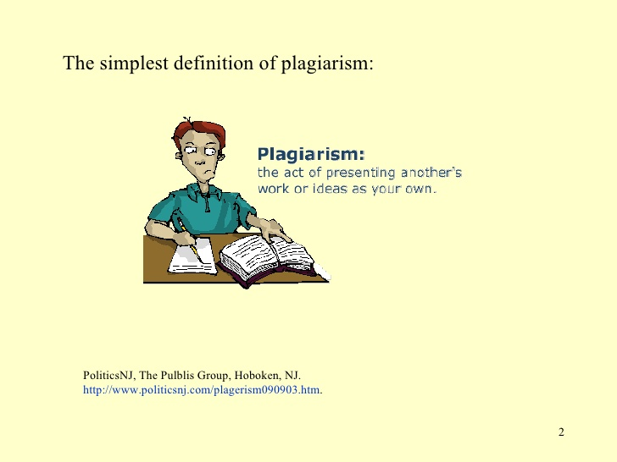

Slide 3
Why is plagiarism important?
Who really cares?
Plagiarism is theft of intellectual property.
Plagiarism is cheating.
Plagiarism will result in receiving a zero for the assignment.

Slide 4
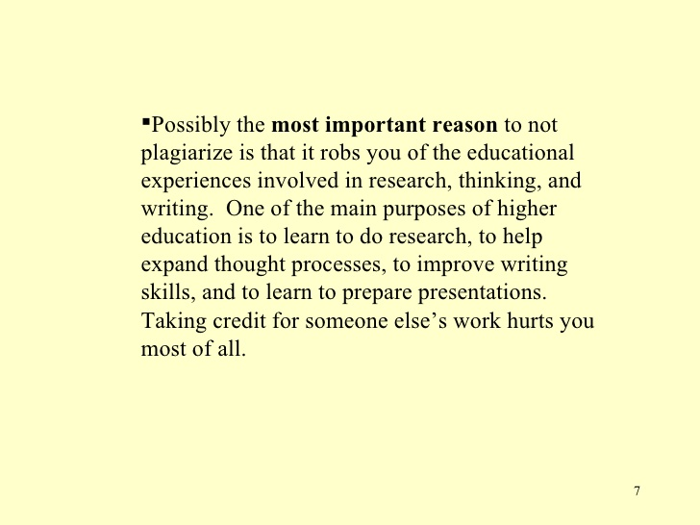

Slide 5
To Avoid Plagiarism, give credit whenever you use:
Another person’s idea, opinion or theory
Any facts, statistics, graphs, drawings – any pieces of information – that are not common knowledge
Quotations of another person’s actual spoken or written words
Paraphrase of another person’s spoken or written words

Slide 6
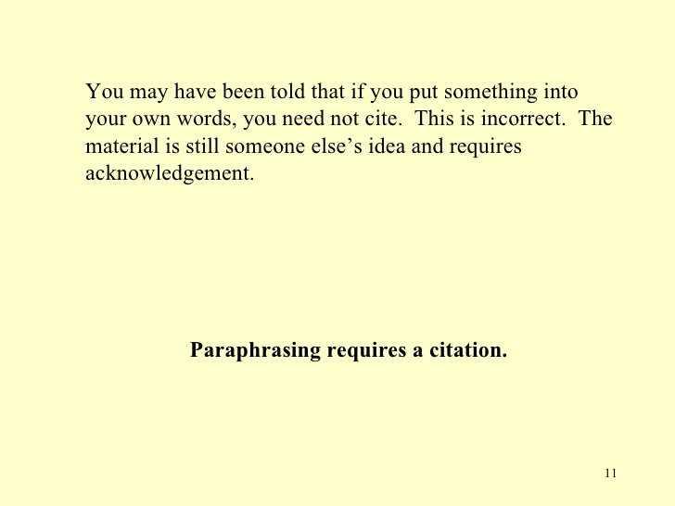

Slide 7
Strategies for Avoiding Plagiarism
CITE EVERYTHING!!!!!!
Put in quotations everything that comes directly from the text
Paraphrase, but be sure you are not just rearranging or replacing a few words
  Read over what you want to paraphrase, then close the text and write without peeking.

Slide 8
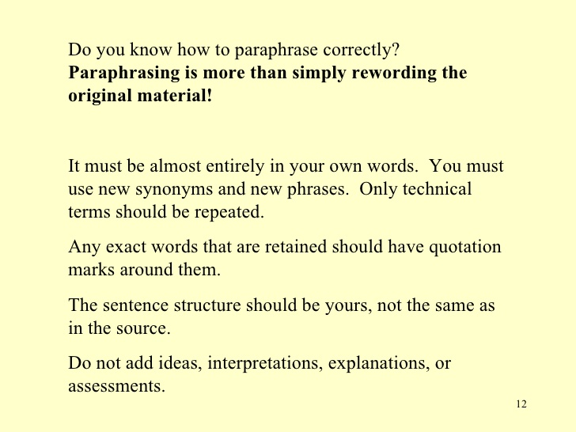

Slide 9
Plagiarism – Ancient practices such as martial arts and meditation show that people of long ago understood the body-mind connection.
Correct Use – Richards says, “Ancient practices such as martial arts and meditation show that people of long ago understood the body-mind connection” (7).

Slide 10
Plagiarism – Martial arts and meditation from ancient times suggest people have long known about the body-mind connection.
Correct Use – The thousand-year old practices of martial arts and meditation show that people have long recognized the body-mind connection (Richards 7).

Slide 11
Plagiarism (Misrepresentation) – It is clear that ancient people understood the body-mind connection.
Correct Use – According to Richards, it is clear that ancient people understood the body-mind connection.

Slide 12
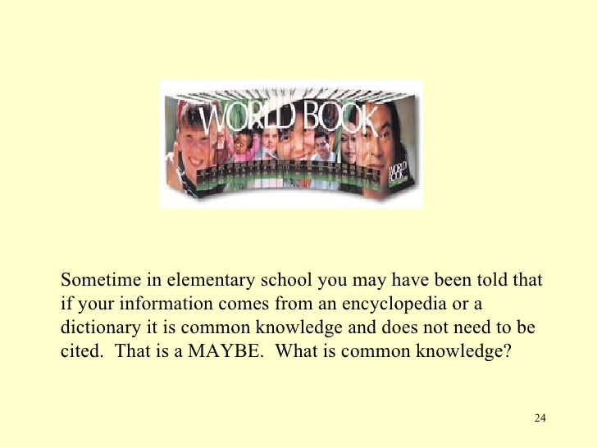

Slide 13
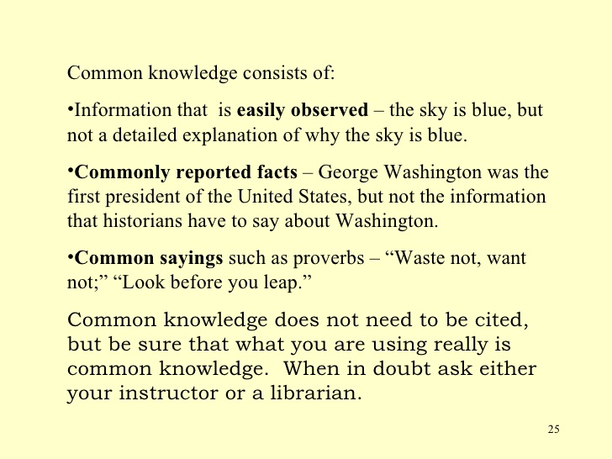

Slide 14
HOW TO CITE
MLA – Modern Language Association
In MLA style, referring to the works of others in your text is done by using what is known as parenthetical citation. This method involves placing relevant source information in parentheses after a quote or a paraphrase.

Slide 15
Parenthetical Citations
Romantic poetry is characterized by the "spontaneous overflow of powerful feelings" (Wordsworth 263).
We see so many global warming hotspots in North America likely because this region has "more readily accessible climatic data and more comprehensive programs to monitor and study environmental change . . ." ("Impact of Global Warming").

Slide 16
Works Cited Pages
citationmachine.net

Slide 17
PAPER FORMAT
Last Name 1
Your Name
Mrs. Pate
Spanish I
05 December 2013
Title of Paper
Now begin writing your paper using the information you properly paraphrase.

