Slide 1
Clarke County Data Governance
The activity around student data privacy has reached a new level of fervor,
with state and federal legislators locked and loaded, ready to take aim at vendors,
districts, and teachers alike.
We all need to start focusing on the basics, starting with policies, procedures, and staff
and student training.
Tech & Learning eNews, May 27, 2015, T&L Advisor Guest post – Steve Young, Chief Technology Officer for Judson
ISD in Texas
Be familiar with the Clarke County Data Governance on our website!
Rev. January 11, 2016

Slide 2
Footnote
Although the Data Governance Policy
And
Technology Usage Policy
Have Common Threads…
They are DIFFERENT POLICIES AND
SERVE DIFFERENT PUPOSES

Slide 3
Clarke County Schools Data Governance Policy
Outlines how operational and instructional activity shall be carried out to ensure Clarke County Schools’ data is accurate, accessible, consistent, and protected.
The document clearly establishes who is responsible for information under various circumstances and specifies what procedures shall be used to manage and protect it.
The Clarke County Schools Policy follows all local, state, and national laws:
The district will abide by any law, statutory, regulatory, or contractual obligations affecting its data systems.

Slide 4
Data Governance
Data Protection and Privacy
Ensuring the security of sensitive and personally identifiable data and mitigating the risks of unauthorized disclosure
Data Security
In its most basic definition, data security means protecting information and information systems from unauthorized access, use, disruption, or destruction

Slide 5
Data Privacy
Data Privacy is:
The relationship between collection and dissemination of data Technology
The public expectation of privacy
The legal and political issues surrounding data

Slide 6
Data Privacy
Strategies that have been implemented or that are in progress:
Provide a website with data policies
Provide guidelines for all contracts and MOAs that involve data
Get to know the Laws
Train staff on data governance, privacy, and security
Make students aware
Incorporate secure means for accessing
Incorporate secure means for sharing and storing data
-- Involve Parents
-- Data Security Must be a Priority (How do we deal with identified security breaches?)
Monitor and Adjust all strategies

Slide 7
Data Security
Strategies have implemented or that are in progress:
Enforce mandatory password changes
Update, maintain, and monitor firewall
Update, maintain, and monitor virus
protection
Update, maintain, and monitor Internet
filtering
Back-up key data
-- Secure wiring closets
-- Update and test Disaster Recovery Plan
Make students aware
Incorporate secure means for accessing and sharing data
--Data Security Must be a Priority (How do
we deal with identified security breaches?)
Monitor and adjust all strategies

Slide 8
What You Need to Know and Do…
Aides
Coaches
Nurses
Librarians
Teachers
Lunchroom
Managers
Office Staff
Administrators
Parents
Students
Bookkeepers
Substitutes
Custodians
Volunteers

Slide 9
The Law!
KNOW which Parents have Opted OUT of FERPA!

Slide 10
Federal Level
Possible changes to FERPA--Collectively, these proposals focus on several key issues:
Prohibiting third party sales of students' data and use of data for advertising or marketing;
Requiring new security practices to protect student data from data breaches;
Limiting the purposes for which students’ data may be disclosed; and
Strengthening parent and student rights to access and modify educational records.

Slide 11
More Laws…
Online Service
KNOW which parents have given the Clarke County
School system permission to act on their behalf
When approving and entering student data for apps
And online programs or services and KNOW the process
evaluating these instructional materials.

Slide 12
Education Records are records that are directly related to a student and that are maintained by an educational agency or institution or a party acting for or on behalf of the agency or institution. These records include but are not limited to the following:
grades,
transcripts,
class lists,
student course schedules,
health records (at the K-12 level), and
student discipline files.
The information may be recorded in any way, including, but not limited to, handwriting, print, computer media, videotape, audiotape, film, microfilm, microfiche, and e-mail.

Slide 13
KNOW What parents/guardians have opted out of FERPA.
KNOW Who to contact about Directory Information questions.
KNOW Where forms can be found and WHEN they are needed.
Directory information is part of the Education Record and includes personal information about a student.
By law, school systems may disclose directory information if it has given public notice to parents of students in attendance and eligible students in attendance concerning “directory information.”
Clarke County Schools DO NOT make public this information lightly and do not share this information unless approved. Requests for large data exports should be made via the online form to the Data Governance Committee for review and approval.

Slide 14
So…What to do or not do?
Data
Security
Keep your Log in information
and Access to data Private and
Protected
Don’t share your devices with
Anyone if email is turned on.

Slide 15
So…What to do or not do?
Monitor your email content.
Don’t take student PII off
campus or discuss in public
places.

Slide 16
So…What to do or not do?
Data Privacy
Use Clarke County web pages to post information when possible.
Creating webpages that require logging in if PII is used.

Slide 17
So…What to do or not do?
Data Privacy
Use Clarke County Schools supported sites that require a secure password and that are https:// sites.

Slide 18
So…What to do or not do?
Data Privacy
Avoid discussing students
on social media.
DO NOT post student pics or
allow classroom visitors to post
pics on any type of social media.

Slide 19
So…What to do or not to do for Privacy and Security?

Slide 20
What are our responsibilities when purchasing online resources…
Clarke County Schools take our student data privacy and safety seriously. For district purchased online resources, we only upload the most basic Directory Information into online resources such as name, homeroom, grade, network login or school email address, and a password.
For students in grades K-6 we load first name and last initial only (when possible) and only upload homeroom and/or grade when absolutely necessary.
When the district department or committee selected online resource is no longer used, the company is contacted to remove student data.
The local schools are requested to do the same for online resources purchased by the individual schools as a school or on behalf of a grade level.
Teachers are asked to do the same for individual resources purchased or used for free by teachers.
Teachers and Local Schools often select apps or online resources that support learning. We ask that teachers and the local school administration be responsible for student data privacy and take great care when having students use the resources and only import, enter, or have students enter two pieces of information. Preferably first name and last initial.
When possible, we ask that they use a nickname or avatar for the student and no names at all. Teachers are responsible for the removal of any student data when these resources are no longer in use. If an online resource is used with students under 14 and not listed on our website, either
NO personally identifiable information about a student such as first name should be entered into the program or
the teacher should request parent permission his/her self. All Data Governance guidelines still apply.

Slide 21
What are your responsibilities…
Follow Clarke
County
Schools
Software
Purchasing
Guidelines
After review, work with your school tech coordinator to only enter or import ONLY the required student information.
Large Data Exports require a second form and should only be performed at the district office.
Notify your school coordinator when you are no longer using the program so that you can contact the company and have the data destroyed.

Slide 22
What are your responsibilities when accepting “terms” using the Click Through Method…
Avoid using more
than 2 pieces
of PII in free
Apps

Slide 23
What are your responsibilities…
Avoid providing or having students enter information on websites or in apps that, alone or in combination, is linked or linkable to a specific student that would allow a reasonable person in the school community, who does not have personal knowledge of the relevant circumstances, to identify the student with reasonable certainty.
It is not so much which pieces of Directory type Information you enter into an online app it is how many pieces of data. More than 2 and you can triangulate and figure how who!

Slide 24
BWF
John
3rd
What if you eliminated just 1 piece of data?

Slide 25
ALSDE Responsibilities to Review Contracts and Agreements
ACT Aspire
Scantron
Chalkable
“To the extent a local school system is involved in administering the Aspire test (for example, sharing student information, test results, and other like information with ACT), the ALSDE’s contract with ACT Aspire covers those actions as it contains data governance clauses which require ACT to comply with FERPA. To the extent a school system shares information with outside parties (for example, by contracting with a third party to print test results/reports or to analyze test data) a school system must enter into its own contract pursuant to FERPA, and the system’s own data governance procedures apply.”

Slide 26
Commonly Asked Questions and Scenarios

Slide 27
Where can this information be reviewed and forms found?

Slide 28
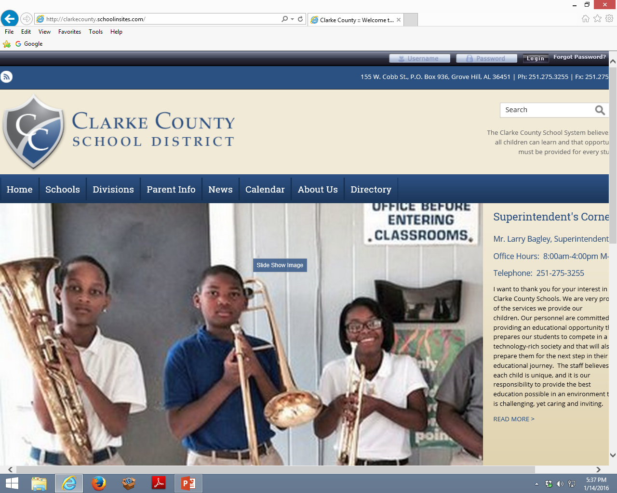

Slide 29
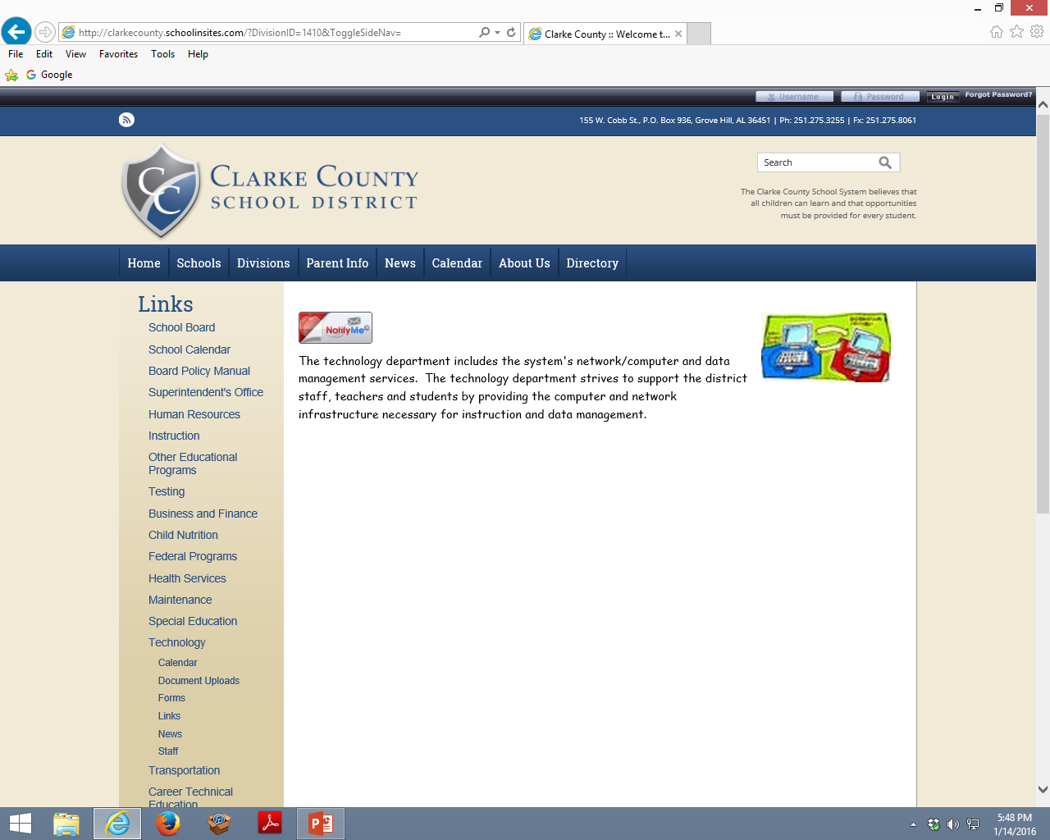
Access Data Governance Policy

Slide 30
Scenario 1: A Handwritten Note
A teacher or administrator writes a note on a pad of paper about a student's behavior in class (good or bad). Would the student have the right to gain access to that document under FERPA?
Because this is a "sole possession" document (whether on paper or electronically on the PC), it does not fall under the definition of a student record. Therefore, a student cannot use FERPA law to force a school system to produce that document.

Slide 31
Scenario 2: E-mail
Two teachers exchange e-mails about the performance of a common student. Could the parents/guardians ask to see this legally under FERPA?
Such a document can be considered an educational record because it is maintained by the school system.

Slide 32
Scenario 3: Posts and Comments
A student creates and posts a blog, forum, etc. to fulfill a class assignment. Could this post ever be considered an educational record?
The opinion on this is vague. By having students post blogs, the teacher risks inadvertently asking students to reveal their class schedules and PII data that is protected under FERPA so it should not be part of a public post.
It is thus always important to ensure that your students know what you are asking of them. A simple solution in this case is for the teacher to give students a lesson on how to make their posts private or to make sure they clearly understand what they can or can not post publically.
Now, let's say a professor publically comments on a student's post. Is this protected under FERPA as part of an educational record?
As long as the professor is not commenting on the grade the student will receive for the assignment, the comment poses no issues under FERPA. But, as usual, be careful what you post!

Slide 33
Scenario 4: Text Messaging and Private Tweets
A teacher, coach, band director, sponsor, etc and a student exchange text messages. Is this protected under FERPA?
If the texts are not maintained by the school system, they cannot be declared an educational record. However, you should always be careful about texting students unless it is a program that keeps your phone number private and the student’s phone number private such as Remind. Individual texts between a student and a staff member are highly discouraged. These messages can sometimes be viewed as inappropriate communications between staff and students.

Slide 34
Scenario 5: Providing PII in the Case of a Student’s Health or Safety
A student’s health or safety is in question and 911 is called. Can we release information about the student to the EMT?
In 2008, the FPCO who is responsible for administering the Family Educational Rights and Privacy Act (FERPA) clarified that if a school determines that there is an articulable and significant threat to the health or safety of a student or other individuals, it may disclose PII to any person whose knowledge of the information is necessary to protect the health or safety of the student or other individuals.
This provision is for Emergencies only and cannot be used for disclosures on a routine, non-emergency basis, such as the routine sharing of non-directory information on students with the local police department (which is not allowed).

Slide 35
Scenario 6: Providing Directory information to certain 3rd Parties?
We use several 3rd party vendors to publish yearbooks, take school pictures, produce school directories, etc. Can we provide directory information to these vendors?
If a district has a policy that they will disclose directory information to entities or purposes that don’t include marketers, but rather will provide directory information only for purposes such as yearbook information, school pictures, or a school directory this is acceptable.
However, we are required to adhere to our stated policy in the directory information notice done online during data verification or enrollment. If a school’s directory information notice to parents and students does not include disclosures to such marketers (3rd parties) or specifically states that it will not make such disclosures then we can’t turn around and disclose directory information to those entities not permitted by the policy. This would be considered an improper disclosure under FERPA. The school district could only do this by revising and reissuing its directory information notice and providing parents or guardians another opportunity to opt out.

Slide 36
Scenario 7: Record keeping requirements
Does the Family Policy Compliance Office (or FPCO) require any recording keeping for the disclosure of PII such as directory information from education records?
School officials need to be familiar with FERPA’s recordkeeping requirements, which you can read about in § 99.32 of the FERPA regulations. Generally, you must record to whom you disclose PII from education records and that party’s legitimate interest in obtaining that information.
When you disclose PII to one of the parties listed in the exceptions to consent (§ 99.31), a school should inform the receiving party that it may not make further disclosures of the PII. (Student Data Confidentiality Form)
There are exceptions to this requirement to record disclosures, such as disclosures made with consent and disclosures to school officials.

Slide 37
Scenario 8: Data that School Nurses can share with County Health Department
Is it a violation of FERPA if the school nurse gives a list of students’ names, phone numbers, and health treatment information (dental, eye, mental health, etc.) to the county health department so that the department can call parents and encourage follow-up for their children?
If the school nurse is under contract to the school or an employee of the school system, then the nurse can be considered a “school official” under FERPA. See § 99.31(a)(1)(i)(B) – “A contractor, consultant, volunteer or other party to whom [a school] has outsourced institutional services or functions may be considered a school official” if certain conditions are met. As a school official/contractor, the nurse is not generally permitted to share information with the health department without consent. MBS request this consent during the online data verification and/or enrollment process. Administrators and Nurses: Know parents that have NOT given consent.

Slide 38
Scenario 9: Health Records
Under FERPA, may a school nurse share medical information about students with other teachers and school administrators? (Related question: Which law – FERPA or the HIPAA Privacy Rule – governs records on health care delivered through a school operated health center?)
At the elementary/secondary level, any records that a school nurse or health center maintains that are directly related to a student are considered “education records” subject to FERPA – not the HIPAA Privacy Rule. A school nurse may share information on students with other school officials if these school officials have a legitimate educational interest in the records. Typically, if there is a health condition about which other teachers and school administrators need to be aware in order to provide a safe and healthy environment for the student, then the school could include such a criteria for what it considers to be a “legitimate educational interest.”

Slide 39
Scenario 10: Directory information about race or ethnicity?
A school designates name, address, telephone listing, email address, and honors and awards received as directory information. A reporter from the local newspaper calls the school and informs the school that he is writing an article about the success of Hispanic students. The reporter asks the school for the name and contact information for all the Hispanic students who made the honor roll for the current school year. Are the names and contact information for all the Hispanic students who made the honor roll for the current school year “directory information”?
NO

Slide 40
Scenario 11: Directory information for students with disabilities
A school designates name, address, telephone listing, email address, and honors and awards received as directory information. A non-profit organization that has programs for special needs children asks the school for directory information on students who have a certain disability. Can the names and contact information for these students be disclosed to the organization as directory information?
NO

Slide 41
Scenario 12: Disclosure of Information to a Police Officer
A police officer shows up at the main office of a high school and he asks if a certain student is attending school today. The police officer does not have a search warrant or a subpoena. The police officer wants to speak to the student regarding some drug activity that occurred three weeks ago. Can the school tell the officer whether or not the student is attending school today?
Technically, NO

Slide 42
Scenario 13: Law Enforcement Maintaining Records
A student is expelled from high school. A copy of his disciplinary record is sent to the school district’s law enforcement unit so that school security can keep the student off campus. The law enforcement unit maintains that record and discloses it to a reporter in response to a State open records request. Is that permissible under FERPA?
NO

Slide 43
Scenario 14: Teacher as a Witness
A teacher personally witnesses an incident, such as one student bullying another. Can the teacher call the victim’s parents and tell them what she observed and who she saw bullying their child?
YES, this is permissible under FERPA. However, you may need to discuss with your school’s counselor or administration before making the call. DO NOT send this type of information through an email.

Slide 44
Scenario 15: Overdue Library Books
A public school district, such as MBS, lists the names of students who have overdue library books on their website, as well as posts the list on the library door. Is this permissible under FERPA?
NO, nor can you post lists whereby students or parents owe money for any activity, etc.

Slide 45
Scenario 16: College Prep or Tutoring Programs
An after school college prep program for high school students/tutoring program for student is an opportunity in which many students elect to participate. How would the program be able to access education records from the school in order to assist the students?
Consent working through parents. Tutors are not given access to Moodle, Google Classroom, or any other MBS Resources

Slide 46
Scenario 17: Working with PTO Representatives
PTO representatives would like Directory information so that they can invite all new students and their families to a social gathering. Can these representatives get access to this information from the school system.
Yes, they must first get the activity approved by the local school administrator, have a data export form request completed by a school office employee, and sign a confidentially form for volunteers. More information available.

Slide 47
Scenario 18: Additional Chalkable(SIS) Permissions.
The local school principal would like for someone that normally does not perform a specific function to have access to all student information? How can this occur?
Confusing. The principal or principal designee is required to complete the “Request for Additional Permissions” form. The Data Governance Committee reviews the request then Approves or Denies. If approved, the IT Department will place the individual in the appropriate permissions group.

