Slide 1
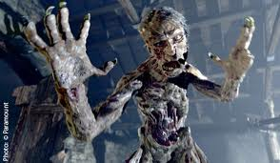
Literary Terms: Beowulf

Slide 2
Alliteration
Alliteration is the repetition of consonant sounds in words (usually at the beginning of the word) that are close together.
Example:
Peter Piper picked a peck of pickled peppers.
Example from Beowulf:
“…Grendel went up to Herot, wondering what the warriors would do in the hall once their drinking was done.”

Slide 3
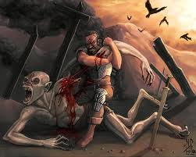
Elegy
An elegy is a poem that mourns the death of a person or laments something lost.

Slide 4
Epic
An epic is a long narrative poem that relates the great deeds of a larger-than-life hero who embodies the values of a particular society.
Most epics share standard characteristics and formulas known as epic conventions, which the oral poets drew upon to help them recall the stories they were recounting.
Epic Conventions
An invocation, or formal plea for aid, to a deity
Action that begins in the middle of the story, then flashes back to events before the narrative’s current time
Predictable metrical structure

Slide 5
Epithet
An epithet is an adjective or other descriptive phrase that is regularly used to characterize a person, place, or thing.
Examples:
Richard the Lion-Hearted
King Alfred the Great
America the Beautiful
The Lord of all Life
The Ruler of Glory

Slide 6
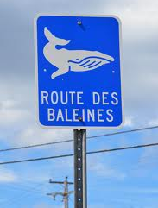
Kenning
A kenning is a metaphorical phrase or compound word used to name a person, place, thing, or event indirectly.
Examples from Beowulf:
“whale-road” = the sea
“shepherd of evil” = Grendel

Slide 7
Caesura
A caesura is a pause or break within a line of poetry, usually indicated by the natural rhythm of the language.
Example:
“Out from the marsh, from the foot of misty
Hills and bogs, bearing God’s hatred,
Grendel came, hoping to kill…”

Slide 8
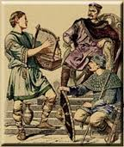
Scop
A scop is an Anglo-Saxon minstrel or poet.
Scops are the Anglo-Saxon equivalents to the ancient Celtic bards.

Slide 9
Vernacular
A way of speaking that is characteristic of a particular region or group of people
Also known as dialect
Beowulf is the oldest piece of vernacular English literature.

Slide 10
Foreshadowing
Foreshadowing is the use of clues to hint at what is going to happen later in the plot.
Arouses the reader’s curiosity and builds suspense
Example:
Hrothgar warns Beowulf of the dangers of a prideful life, and how such a life will ultimately lead to ruin. This warning actually foreshadows the events that will take place during Beowulf’s later years.

Slide 11
Allusion
An allusion is a reference to a statement, person, place, event, or thing that is known from literature, history, religion, mythology, politics, sports, science, or popular culture.
Example from Beowulf:
References to Biblical stories

Slide 12
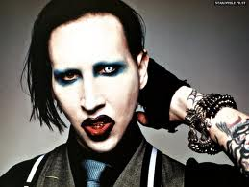
Hyperbole
A figure of speech that uses exaggeration to express strong emotion, to make a point, or to evoke humor
Example:
My aunt uses so much makeup, Marilyn Manson freaked out when he saw her.

Slide 13
Personification
A figure of speech in which an animal, an object, a force of nature, or an idea is given human characteristics
Example:
Computers hate me.

Slide 14
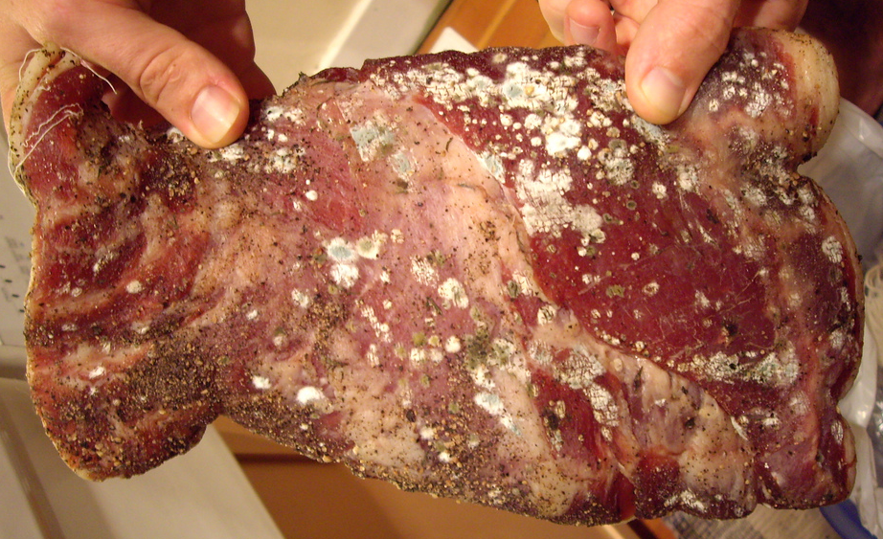
Metaphor
A figure of speech that is an implied comparison between seemingly unlike things
Example:
Their love was sickening. She was a colony of E.coli growing on him, the room temperature Canadian beef.

Slide 15
Simile
A figure of speech that makes comparisons using the words “like,” “as,” or “than.”

Slide 16
Beowulf
Beowulf is the oldest surviving epic poem in the English language.
It was written in Old English, the language of the Saxons.
Originally untitled, in the 19th century the poem began to be called by the name of its Scandinavian hero, whose adventures are its primary focus.
Historical elements run through the poem, yet both the hero and the story are fiction.

Slide 17
The Archetypal or Epic Hero
Unusual circumstances of birth; sometimes in danger or born into royalty
Leaves family or land and lives with others
An event leads to an adventure or a quest
The hero has a special weapon only he can wield
The hero always has supernatural help
The hero must prove himself many times while on adventure
The Journey and the Unhealable Wound
Hero experiences atonement with the father
When the hero dies, he is rewarded spiritually

